Slide 1
Interconnection Structures
Muhammad Afzaal
m.afzaal@nu.edu.pk

Slide 2
Book Chapter
“Computer Organization and Architecture”
Author “William Stallings”
8th Edition
Chapter 3
Section 3.3
Section 3.4

Slide 3
Interconnection Structures
Three basic computer components
Processor
Main memory
I/O Devices
They need to interact with each other to perform their functions
Collection of paths connecting above modules is called Interconnection Structures
Type of connection depends upon the module
Memory Connection
I/O Module Connection
CPU Connection

Slide 4
Memory Connection
Receives and send data
Receives addresses of memory locations
Receives control signals
Read
Write
Timing

Slide 5
I/O Module Connection
Similar to memory from computer’s viewpoint
Input connection
Receives data from peripheral
Sends data to computer
Output connection
Receives data from computer
Sends data to peripheral

Slide 6
CPU Connection
Reads instructions and data
Writes out data after processing
Sends control signals to other units
Receives and acts on interrupts

Slide 7
Bus Interconnection
A Bus is a communication path connecting two or more devices
Each bus consists of single/multiple lines
Bus that connects major computer components like processor, memory and I/O, is called System Bus
Bus lines can be classified into three different types depending upon their functionality
Data Lines
Address Lines
Control Lines

Slide 8
Data Lines
Used to move data between system modules
Called Data Bus altogether
Carries data
Remember that there is not any difference between “data” and “instruction” at this level
Width is a key determinant of performance
32, 64 or 128 data lines
Number of lines is equal to the number of bits transferred at one time

Slide 9
Address Lines
Identify the source or destination of data
e.g. CPU needs to read an instruction from a given location in memory
Bus width determines maximum memory capacity of system

Slide 10
Control Lines
Control the use of data and address lines
Used to transmit command and timing signals
Timing signals indicate the validity of data and address information
Command signals specify operation to be executed
Typical control signals include
Memory read/write signal
Interrupt request
Clock signal

Slide 11
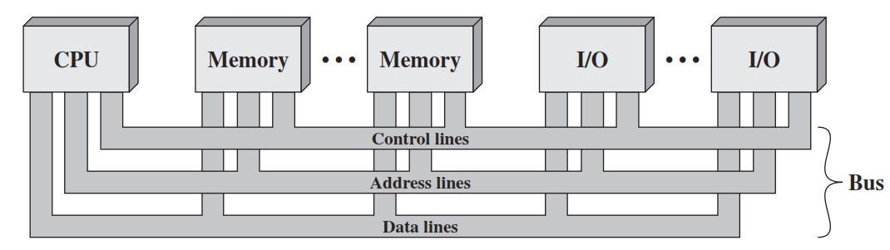
Bus Interconnection Scheme

Slide 12
Speed Issues
Different devices have different transfer/operate speed
If the speed of bus is bounded by the slowest device connected to it, the efficiency will be very low
How to solve it?
A common approach is using buffers

Slide 13
Single Bus Problems
Lots of devices on one bus leads to
Propagation delay
Long data paths mean that coordination of bus use can adversely affect performance
Aggregate data transfer approaches bus capacity
Most systems use multiple buses to overcome these problems

Slide 14
Bus Types
Dedicated Bus
Permanently assigned one function
Separate Data and Address lines
Multiplexed Bus
Shares lines
Address valid or Data valid control line
Advantage – fewer lines
Disadvantage
More complex circuitry
Potential reduction in performance

Slide 15
Bus Arbitration
More than one modules may need control of the bus
Only one unit at a time can successfully transmit over the bus
Arbitration may be
Centralized
Single hardware device controlling the bus access
Distributed
Each module may claim the bus
Control logic on all modules

Slide 16
Timing
Coordination of events on bus
Synchronous
Events determined by clock signals
Control Bus includes clock line
All devices can read clock line
Usually a single cycle for an event

Slide 17
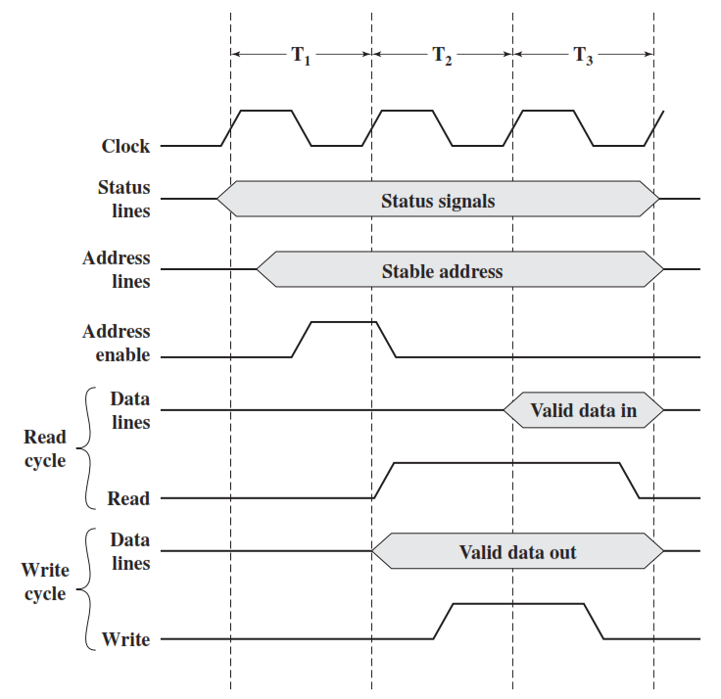
Synchronous Timing Diagram

Slide 18
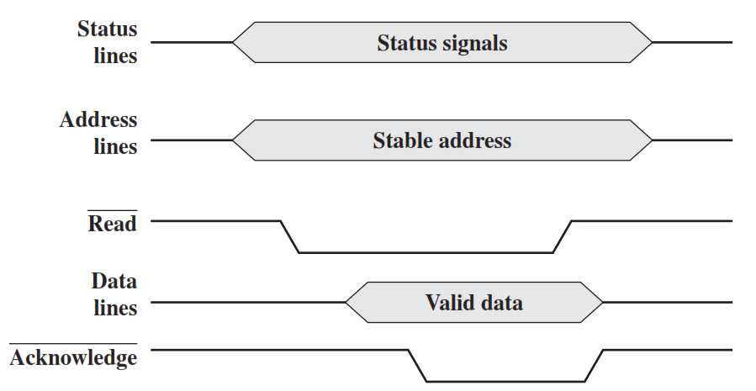
Asynchronous Timing Diagram
System bus read cycle

Slide 19
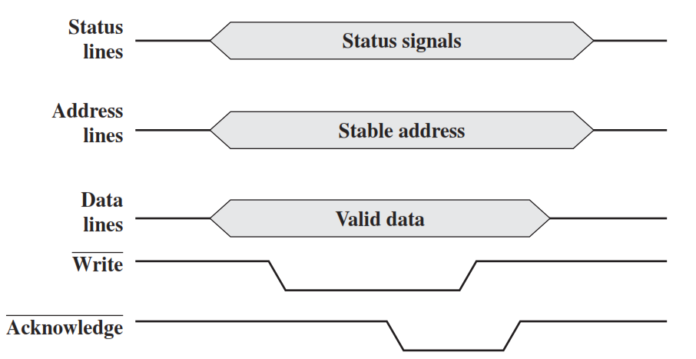
Asynchronous Timing Diagram
System bus write cycle

Slide 20
Synchronous vs. Asynchronous
Synchronous timing is simpler to implement
Less flexible than asynchronous timing
Because all devices on synchronous bus are tied to a fixed clock rate, the system cannot take advantage of advances in device performance
With asynchronous timing, a mixture of slow and fast devices, using older and newer technology, can share a bus

